Slide 1

The Comparison of Local and Global Early Fake News Detection Methods
Maciej Pawlikowski, Hubert Ruczyński,
Bartosz Siński, Adrian Stańdo
Notes:
Good morning, during today’s presentation we want to talk about the results concerning the task of early fake news detection with the usage of local methods.

Slide 2
Main goals
Comparison of different topic detection models.
Comparison of fake news detection methods.
Introduction of local fake news detection methods.
Evaluation of the local approach, and comparison to corresponding global solutions.
Exploration of models differences between the two strategies with the usage of XAI.
Notes:
We can outline 5 major goals of our project.
The first one concerns comparing different topic detection methods and pointing at the best-performing ones.
The second does the same for fake news detection methods.
The third, and most important one is the introduction of local fake news detection methodology,
The next one evaluates this approach and compares the obtained results with the global solution.
Finally, the last goal is to describe the differences between the global model, and the local ones, and see why something performs better.

Slide 3
Methodology
Notes:
To visualize the pipeline present in our solution, we will use the diagram presented on this slide. We can see all stages, starting from the data source to the outcomes, and explanation of the models

Slide 4
Topic detection
Clustering Algorithm | Lemmas |  | Noun chunks
Clustering Algorithm | Silhouette Score (↑) | Calinski-Harabasz Score (↑) | Silhouette Score (↑) | Calinski-Harabasz Score (↑)
TF-IDF + K-Means | 0.038 | 293.9 | 0.067 | 314.1
Doc2Vec + K-Means | 0.134 | 449.6 | 0.386 | 3473.24
LDA | 0.607 | 18668.8 | 0.883 | 110432.1
TF-IDF + LDA | 0.873 | 91490.7 | 0.929 | 323993.32
LSI | -0.320 | 49.5 | -0.512 | 132.0
TF-IDF + LSI | 0.469 | 1655.9 | -0.290 | 393.5
GSSDMM | 0.714 | 529.4 | 0.867 | 15681.4
Notes:
We can outline 5 major goals of our project.
The first one concerns comparing different topic detection methods and pointing at the best-performing ones.
The second does the same for fake news detection methods.
The third, and most important one is the introduction of local fake news detection methodology,
The next one evaluates this approach and compares the obtained results with the global solution.
Finally, the last goal is to describe the differences between the global model, and the local ones, and see why something performs better.

Slide 5
Fake News Detection
Model | No clustering
Model | Accuracy (↑) | Accuracy w/o politics (↑)
Logistic Regression | 0.581 | 0.628
SVM | 0.518 | 0.577
Random Forest | 0.491 | 0.540
Naive Bayes | 0.444 | 0.501
DistilBERT | 0.710 | 0.790
Notes:
We can outline 5 major goals of our project.
The first one concerns comparing different topic detection methods and pointing at the best-performing ones.
The second does the same for fake news detection methods.
The third, and most important one is the introduction of local fake news detection methodology,
The next one evaluates this approach and compares the obtained results with the global solution.
Finally, the last goal is to describe the differences between the global model, and the local ones, and see why something performs better.

Slide 6
Global and local models
Model | No clustering (Global Model) | GSSDMM (Local Models) | LDA (Local Models)
Logistic Regression | LR | GSSDMM + LR | LDA + LR
SVM | SVM | GSSDMM + SVM | LDA + SVM
Random Forest | RF | GSSDMM + RF | LDA + RF
Naive Bayes | NB | GSSDMM + NB | LDA + NB
DistilBERT | D-BERT | GSSDMM+D-BERT | LDA + D-BERT
Notes:
We can outline 5 major goals of our project.
The first one concerns comparing different topic detection methods and pointing at the best-performing ones.
The second does the same for fake news detection methods.
The third, and most important one is the introduction of local fake news detection methodology,
The next one evaluates this approach and compares the obtained results with the global solution.
Finally, the last goal is to describe the differences between the global model, and the local ones, and see why something performs better.

Slide 7
Global vs local - performance
Model | No clustering |  | GSSDMM | LDA
Model | Accuracy (↑) | Accuracy w/o politics (↑) | Weighted Accuracy (↑) | Weighted Accuracy (↑)
Logistic Regression | 0.581 | 0.628 | 0.540 | 0.530
SVM | 0.518 | 0.577 | 0.460 | 0.480
Random Forest | 0.491 | 0.540 | 0.470 | 0.460
Naive Bayes | 0.444 | 0.501 | 0.440 | 0.450
DistilBERT | 0.710 | 0.790 | 0.600 | 0.620
Notes:
We can outline 5 major goals of our project.
The first one concerns comparing different topic detection methods and pointing at the best-performing ones.
The second does the same for fake news detection methods.
The third, and most important one is the introduction of local fake news detection methodology,
The next one evaluates this approach and compares the obtained results with the global solution.
Finally, the last goal is to describe the differences between the global model, and the local ones, and see why something performs better.

Slide 8
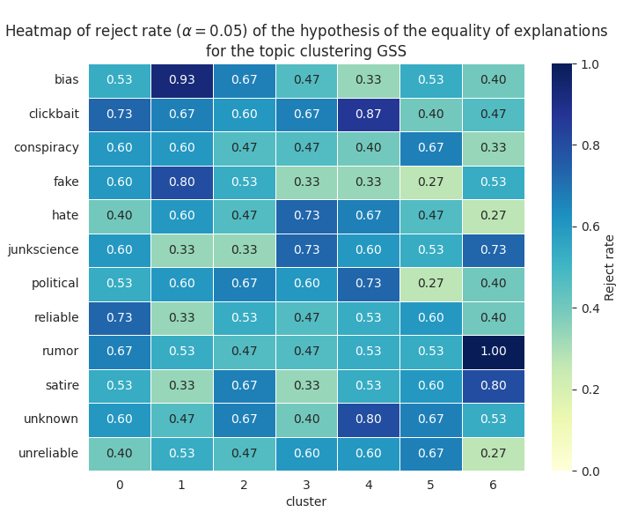
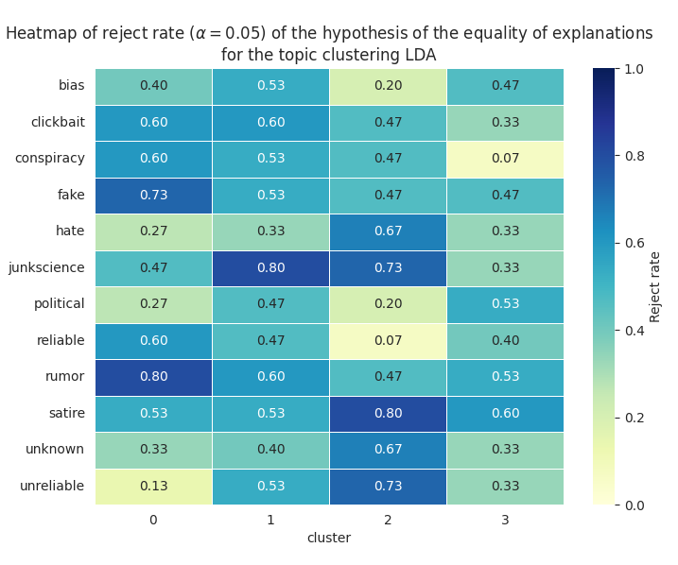
Global vs local – XAI (IG)
Notes:
We can outline 5 major goals of our project.
The first one concerns comparing different topic detection methods and pointing at the best-performing ones.
The second does the same for fake news detection methods.
The third, and most important one is the introduction of local fake news detection methodology,
The next one evaluates this approach and compares the obtained results with the global solution.
Finally, the last goal is to describe the differences between the global model, and the local ones, and see why something performs better.

Slide 9
Limitations
Computational resources – only private PCs.
Consideration of only 12,000 observations (out of 9,000,000 accessible!).
Consideration of 12 classess in such a small dataset.
Additional split into 4 and 7 clusters (results in ~250 and ~150 per class in clusters).
Employment of relatively simple models, only one transformer.
Notes:
We can outline 5 major goals of our project.
The first one concerns comparing different topic detection methods and pointing at the best-performing ones.
The second does the same for fake news detection methods.
The third, and most important one is the introduction of local fake news detection methodology,
The next one evaluates this approach and compares the obtained results with the global solution.
Finally, the last goal is to describe the differences between the global model, and the local ones, and see why something performs better.

Slide 10
What could we improve?
Task simplification to 2 or 4 classes instead of 12.
Double the amount of observations to 24,000.
For local approaches with 4 and 7 clusters it results in ~3000/1500 and ~1500/750. osbervations per class, which is 12/6 times more than before.
Consider more transformer models, such as BERTopic.
Notes:
We can outline 5 major goals of our project.
The first one concerns comparing different topic detection methods and pointing at the best-performing ones.
The second does the same for fake news detection methods.
The third, and most important one is the introduction of local fake news detection methodology,
The next one evaluates this approach and compares the obtained results with the global solution.
Finally, the last goal is to describe the differences between the global model, and the local ones, and see why something performs better.

Slide 11
Further works with more resources
Expansion to even greater numer of articles (100,000 observations).
Consideration of more/all classes.
Consideration of more topic detection methods (not only clustering models).
Testing even more advanced models as Fake News detectors (transformers, LLMs).
Deployment of the framework (best combination) as an online learning system.
Consideration of online learning clustering methods, e.g. TextClust.
Notes:
We can outline 5 major goals of our project.
The first one concerns comparing different topic detection methods and pointing at the best-performing ones.
The second does the same for fake news detection methods.
The third, and most important one is the introduction of local fake news detection methodology,
The next one evaluates this approach and compares the obtained results with the global solution.
Finally, the last goal is to describe the differences between the global model, and the local ones, and see why something performs better.

Slide 12
Thank you for your attention!

